Slide 2
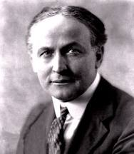
The Life of Harry Houdini

Slide 3
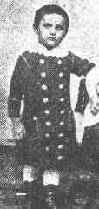
Harry Houdini was born on March 24, 1874 in Budapest, Hungary, with the name of Ehrich Weisz. He was one of six children and the son of a Rabbi. In 1876, Ehrich and his family immigrated to the United States.

Slide 4
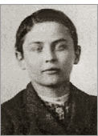
On October 28, 1883, nine year old Ehrich made his first appearance on stage, performing a trapeze act. He called himself, "Ehrich, the Prince of the Air.”

Slide 5
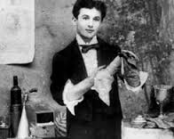
A few years later, Ehrich and his brother began to have an interest in magic. As a stage name, Ehrich Weiss became Harry Houdini. At 17, Ehrich, now known as Harry Houdini, left his family to pursue his magic career.

Slide 6
By the age of twenty, Harry had been performing small acts throughout New York. He got married and joined a circus where he began to develop and perfect his escape tricks.

Slide 7
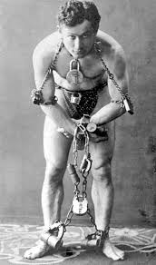
Through the years, Houdini gained fame by escaping from police handcuffs and jails.

Slide 8
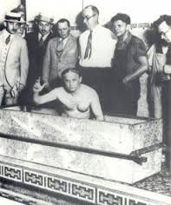
After making his name in America, Harry toured Europe, where he expanded his act by escaping from straitjackets and coffins. Eventually, Harry had a full show for his magic.

Slide 9
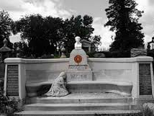
On October 24, 1926 Houdini died because he got punched in the abdomen by J. Gordon Whitehead and refused to seek medical help. He died at the age of 52.

Slide 10
Click here to watch Houdini’s straightjacket escape
http://youtu.be/3r8qr-p9z5g

Slide 11
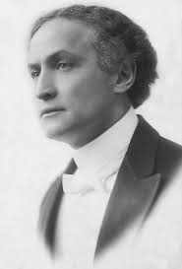
I hope you enjoyed! Thank you!

