Slide 1
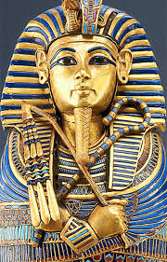
King Tutankhamen
The Boy King
c. 1341-1323 B.C.E.

Slide 2
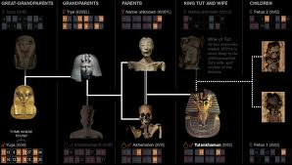
Family
Tut was the son of Akhenaten and Akhenaten’s sister.
His wife was Ankhesenanun, his half sister.
He had no male children.
His only kids were girls, and they were still-born, which means they were never alive.
His mother’s name is unknown.

Slide 3
Domestic Policy
Tut had a regent because he was 8 years old.
He changed Egypt back to a polytheistic country.
He became pharaoh at 8.
His regent became pharaoh after he died.
Tut moved the capital city back to Thebes and Memphis.

Slide 4
Foreign policy
He was in a war with the Nubians and the Asiatics.
He died while fighting the Hittites.
Tut wanted to restore relations with other countries.
After Tut’s death, Egypt was defeated in a war because they had no king.
He didn’t expand Egypt’s borders.

Slide 5
Famous
His golden death mask weighed 10 kilos.
The first person who entered the tomb suddenly died.
Ruled for eight to ten years in 1332-1323B.C.E
His original name was Tutankhamen.
Scientists used technology to find out why he died.

Slide 6
THANK YOU
FOR
WATCHING!!!

