Slide 1
Ramses II
By Natalia and Kolya
Ramses The Great
1272 B.C.- 1213 B.C.

Slide 2
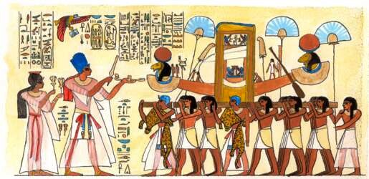
Family
He might have had one of the largest families.
He had up to 50 sons and 50 daughters.
He had many wives.
He was the 3rd king of the 19th dynasty.
He took the throne at a late age, in his late teens.

Slide 3
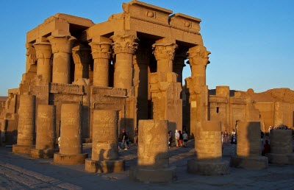
Domestic Policy
A lot of temples were built because Egypt was rich.
The reign of King Ramses II was the most noble in Egypt’s history.
He built the Hypostyle Hall in Karnak (now Thebes).
In Nubia, he built no less than 6 temples.
He built many pyramids.

Slide 4
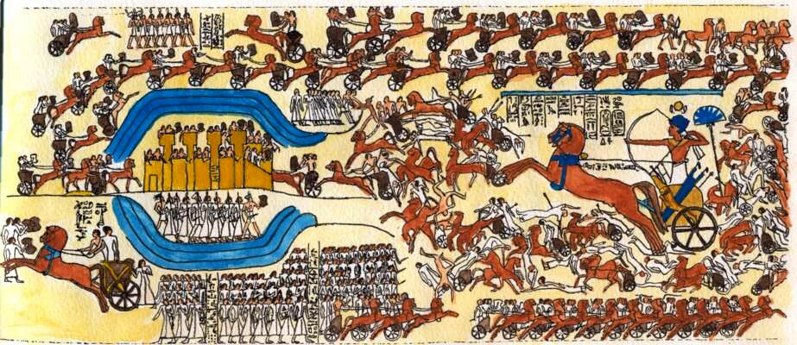
Foreign Policy
He secured Egypt’s borders very well.
He led the Egyptian army in battles against many enemies, including the Hittites.
In a battle against the Hittites, the battle of Kadesh, his army was almost defeated.
Ramses eventually established a major peace treaty with the Hittites.
After the peace treaty, he married the Hittite prince’s daughter.

Slide 5
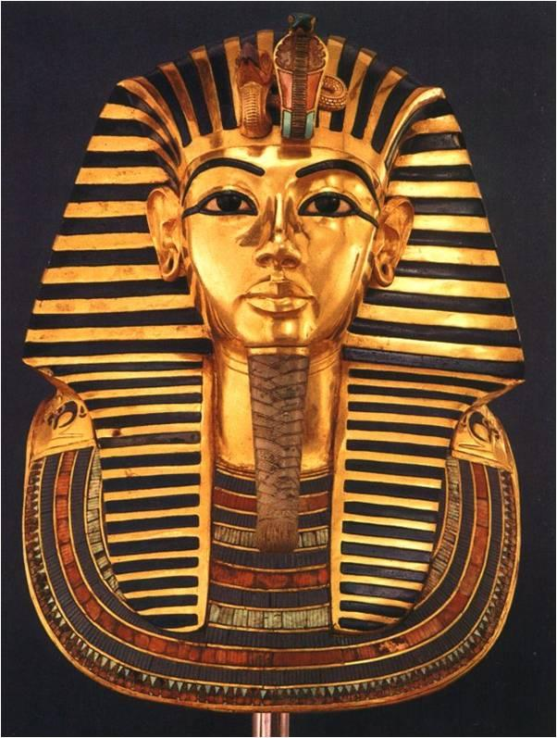
Fun Facts
Ramses II built and rebuilt many temples.
He may be the pharaoh from Exodus.
He reigned for 67 years.
Ramses II lived extremely long for his time- 90 Years!

