Slide 2
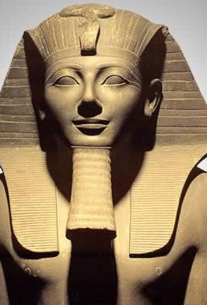
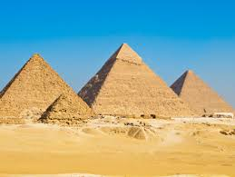
Thutmose III
By:
Yehuda HaLevi
and Logan Titus

Slide 3
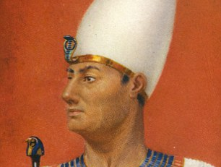
Born 1482 B.C. Died 1425 B.C. Reigned from 1479 BC to 1425 BC

Slide 4
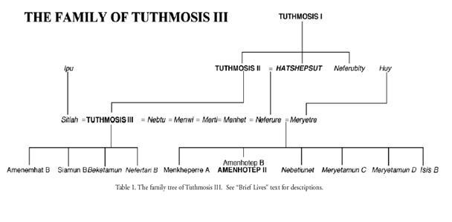
Thutmose III’s Family
Thutmose II = his father
Amenhotep = his son
Hatshepsut = his aunt/stepmother
Iset = his mother
Siamun = his son

Slide 5
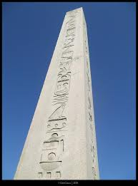
Domestic Policy
Made monuments
Created a peaceful land
Improved Egypt’s wealth
Set up many obelisks
Because he was a great pharaoh, Egypt was the largest when he reigned.

Slide 6
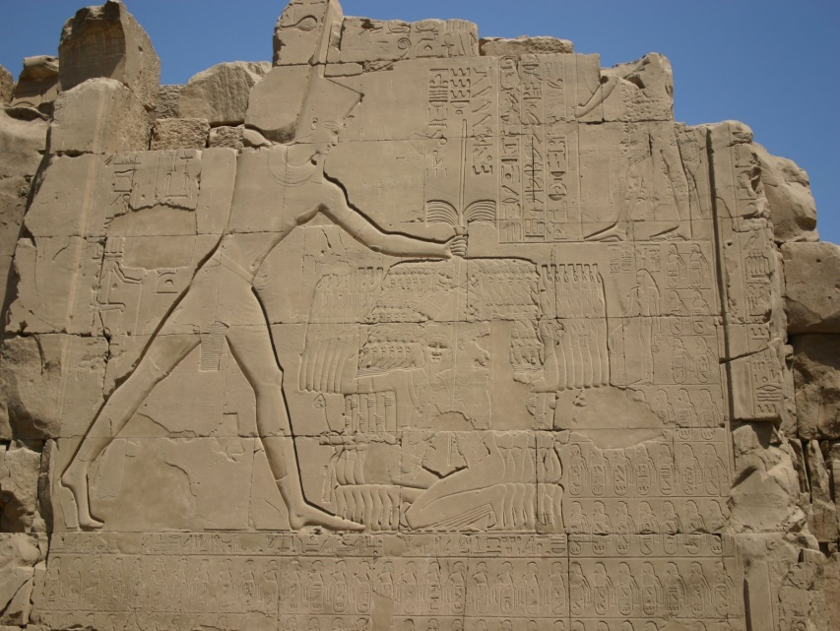
Foreign Policy
Forced the Hyksos out of Egypt
Invaded Syria and Palestine 17 times
Arch Enemy=Kadesh
Marched into Megiddo to subdue the prince of Kadesh
Took hostages from many countries

Slide 7
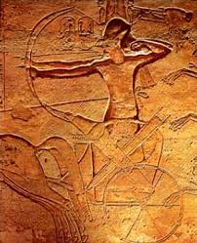
Famous For:
Warrior King of Egypt’s 18th and largest dynasty
Hatshepsut was both his aunt and stepmother.
Conquered some of Israel, Lebanon, and Syria
His battle of Megiddo is recorded on the walls of Karnak.
When Hatshepsut died, he destroyed everything she built.

Slide 8
Thanks For Learning about Thutmose III

